Slide 1



Behind the Internet: what IXPs are, how they work, and why they matter
Eurekalabria

Slide 2


Slide 3
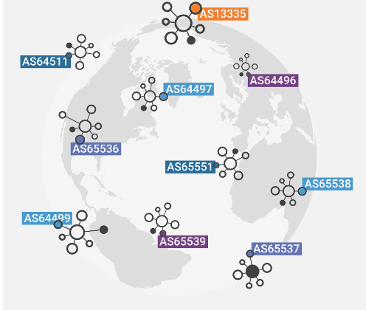
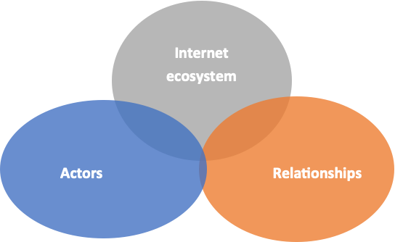
How does Internet operate?
Internet isn't a single network – It's a collection of over 110,000 Autonomous Systems (ASNs) agreeing to talk to each other and it critically depends on adequate interconnections between participants.
Global ASN Infrastructure
Over 110,000 Autonomous Systems routing data
Ecosystem Interconnections
Convergence of Actors, Ecosystem & Relationships

Slide 4
How does Internet operate?
INTERCONNECTIONS
Autonomous Systems can interconnect with each other through a hierarchical structure, typically regulated by commercial agreements, or based on a logic of mutual benefit.
Based on their nature, interconnections are divided into:
INTERNET
Transit
When one AS provides another AS with access to the global Internet.
TRANSIT
TRANSIT
Peering
When two Autonomous Systems interconnect to exchange traffic and access to their respective networks/resources directly.
PEERING

Slide 5






















What is an Internet Exchange Point
Neutral Interconnection Hub:
IXPs offer a carrier-neutral infrastructure where ISPs, CDNs, and Content Providers converge to establish direct peering sessions and optimize connectivity costs.
CONTENT PROVIDERS
DDOS SERVICES
INTERNATIONAL CARRIERS
ANYCAST REPLICAS OF ROOT NAME SERVERS
IXP
NATIONAL PROVIDERS
F-Root,
J-Root,
ccTLD, etc..
Direct AS-to-AS Traffic Exchange:
Allows ASNs to interconnect directly, rather than through third-party upstream providers (Transit)
LOCAL ISPS
RESEARCH NETWORKS
CDNS

Slide 6
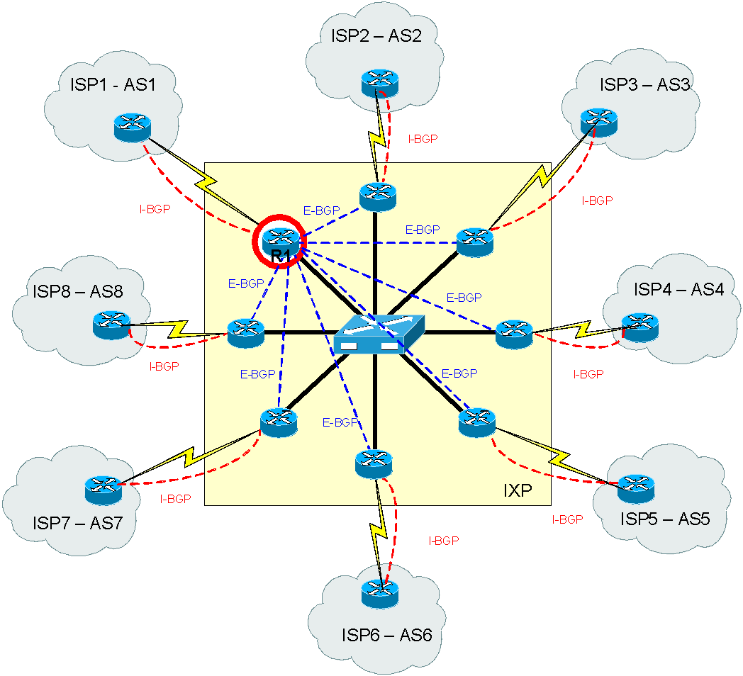
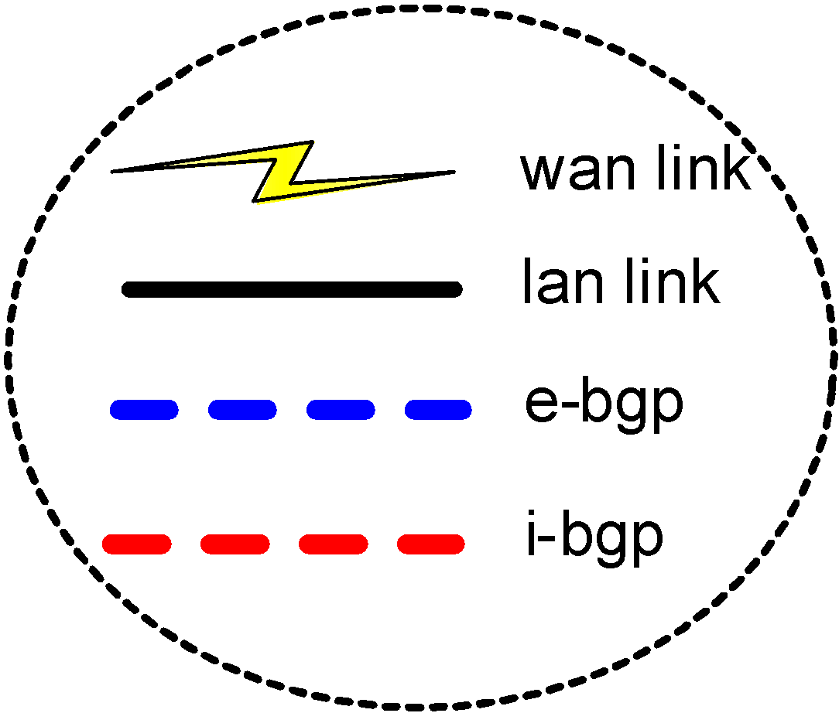
What is an Internet Exchange Point
THE PEERING PLATFORM

Slide 7

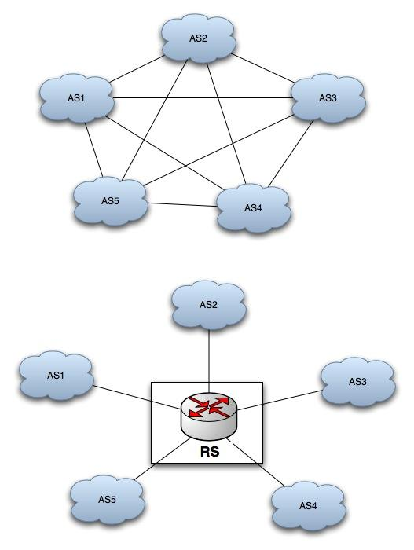
Route Servers
WHAT?
Route Servers (RS) provide support for the establishment of peering sessions between IXP peers: theoretically, a single peering session replaces a complex full mesh BGP interconnection.
WHY?
Reach a lot of parties with just one BGP session
Providing backup for direct peering sessions
Preventing / Mitigating misconfigurations (hijacks)
Easy entry point for new members to the exchange – immediate traffic
Security features (Route Object / ROA RPKI validation)

Slide 8
Peering key factors
01
Keep local traffic local
02
Security
03
Resilience

Slide 9
Why peer – Keep local traffic local
Performance
Lowers the latency
Direct local interconnects minimize path lengths and eliminate unnecessary transit hops.
Increase the throughput
Maximizes available bandwidth capacity and avoids long-haul network bottlenecks.
Improves user experience in terms of speed and stability
Delivers seamless, highly reliable end-user connectivity and fast loading times.

Slide 10
Tromboning effect
WHAT IS “TROMBONING”?
A routing inefficiency where traffic generated in and destined for the same geographical area travels hundreds of kilometers to a distant international hub before returning to a neighboring network.
WHY DOES IT HAPPEN?
Occurs when two local Autonomous Systems (ASNs) lack direct local interconnection and rely exclusively on upstream IP Transit providers.
THE CONSEQUENCES:
01
High Latency
Unnecessary propagation delay for real-time services (VoIP, Cloud, Streaming).
02
Higher Operational Costs
Operators pay per-Mbps transit fees for traffic that should be local.
03
Single Point of Failure
Local communication breaks if international subsea/dorsal links cut.

Slide 11
Case study:
EG-IX

Slide 12


Why Egypt?

Slide 13
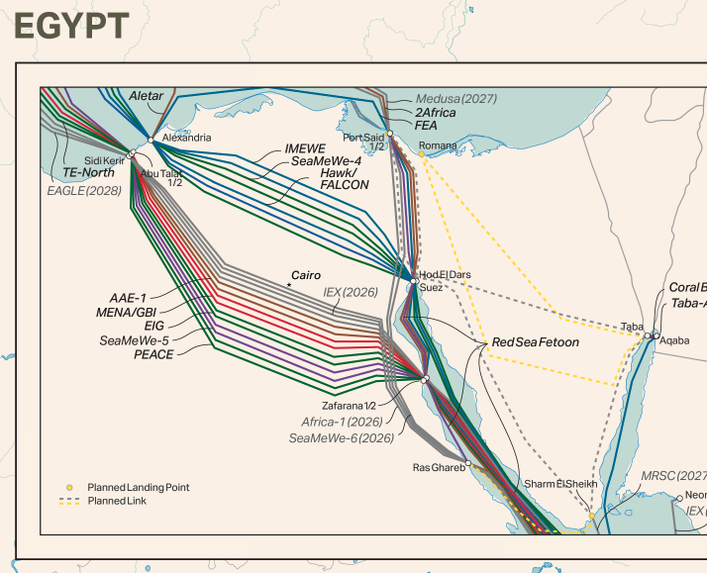
Case study: EG-IX
Real-World Impact: The EG-IX Cairo Case Study
The Subsea Cable Chokepoint (CSIS Study):
Egypt is the 2nd most critical hub worldwide for subsea cables (after the US). Located at the intersection of 20+ international submarine cable systems.
Handles 16–17% of global Internet traffic and over 30% of Europe-to-Asia traffic across Suez.
The "Pass-Through" Problem:
Despite hosting massive subsea capacity, local inter-ISP traffic was historically backhauled to European hubs (Marseille, Frankfurt), causing 70–90 ms latencies locally.
https://submarine-cable-map-2026.telegeography.com/

Slide 14
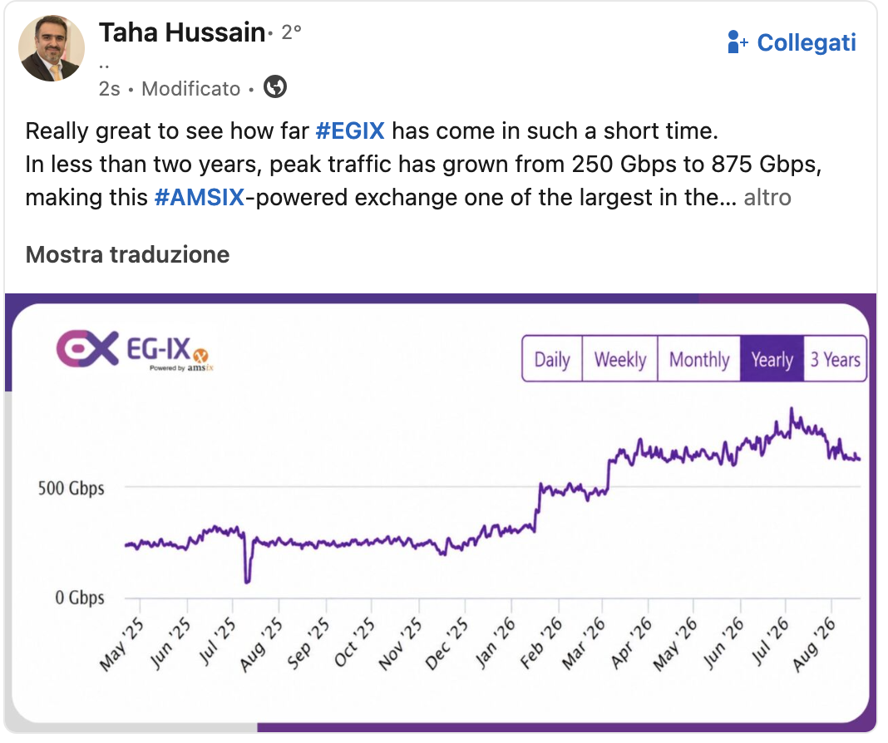
Case study: EG-IX
Real-World Impact: The EG-IX Cairo Case Study
EG-IX launched March 2022 by Telecom Egypt powered by AMS-IX (IXaaS) inside the Regional Data Hub (RDH) in Cairo.
After EG-IX Deployment (Cairo):
Latency Drop: Reduced by over 90% (from ~80 ms down to < 5 ms).
CDN Localization: Major CDN nodes (Google, Meta, Cloudflare) connected directly to the local IXP fabric.
Value Retention: Transformed Egypt from a passive subsea transit corridor into an active regional peering hub.
https://www.peeringdb.com/ix/3812

Slide 15
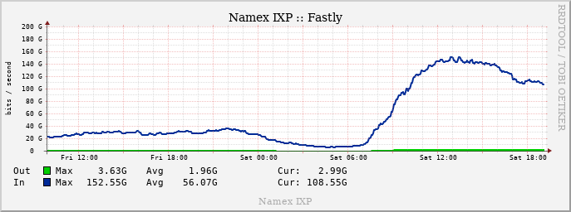
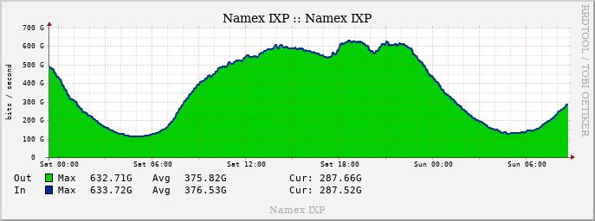

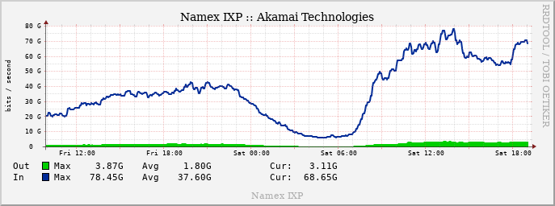
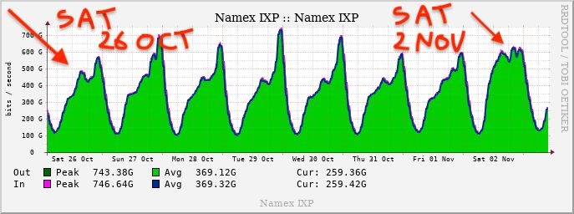
Why peer – Keep local traffic local
Fortnite update Saturday 2nd Nov 2024

Slide 16
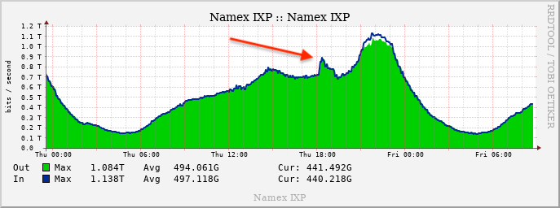
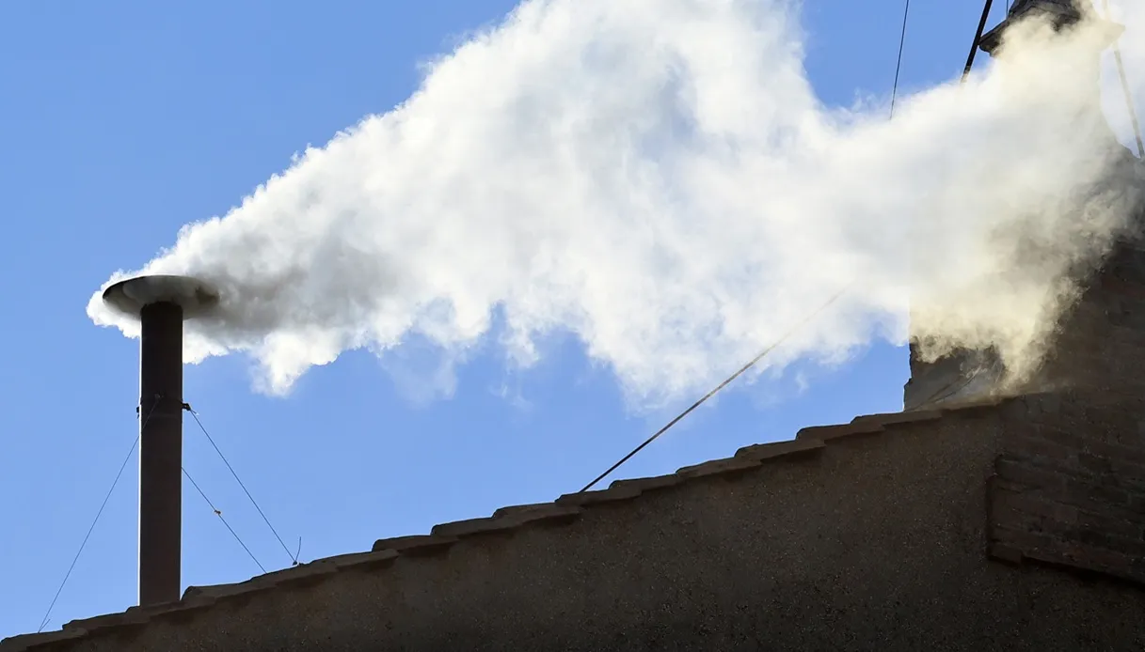
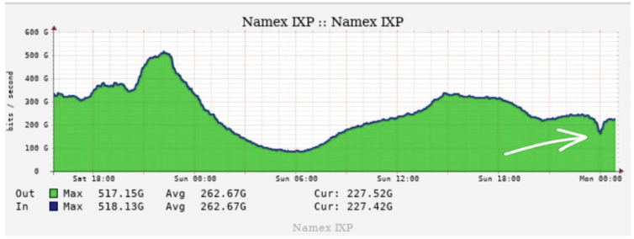
Why peer – Keep local traffic local
Funny profiles
8 May 2025: the white smoke announcing the
election of the new Pope
The live stream broadcast by Raiplay
The usual traffic dip during the New Year’s Eve midnight celebrations

Slide 17
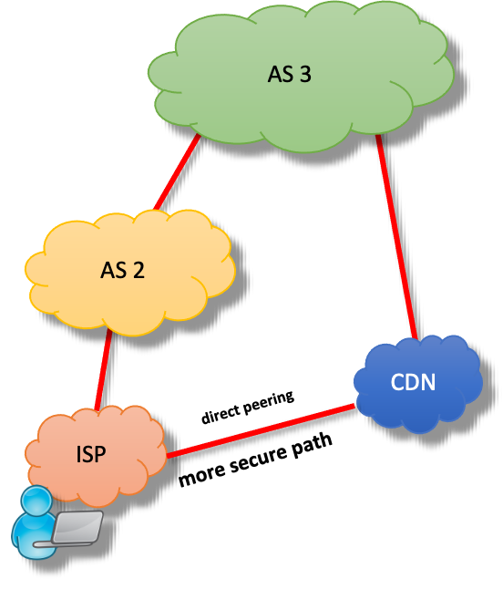
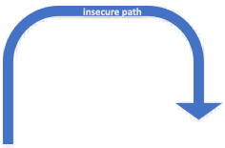
Why peer – Security
Security
Greater Control
Direct peering provides full authority over traffic flows, bypassing untrusted third-party networks.

Slide 18
Why peer – Resilience
Resilience
Increase of number of possible “paths”
Creates redundant routing options to ensure continuous and uninterrupted data delivery.
Improves overall bandwidth
Optimizes available throughput capacity and prevents severe network congestion bottlenecks.
Backup for Transit Disruption
Provides seamless failover connectivity whenever primary transit providers experience outages.

Slide 19










IXPs in Italy
MIX Milano
MINAP Milano
Top-IX Torino
VSIX Padova
Ge-DIX Genova
Namex Roma
Namex Napoli
Namex Bari
DE-CIX Palermo
MIX Palermo

Slide 20
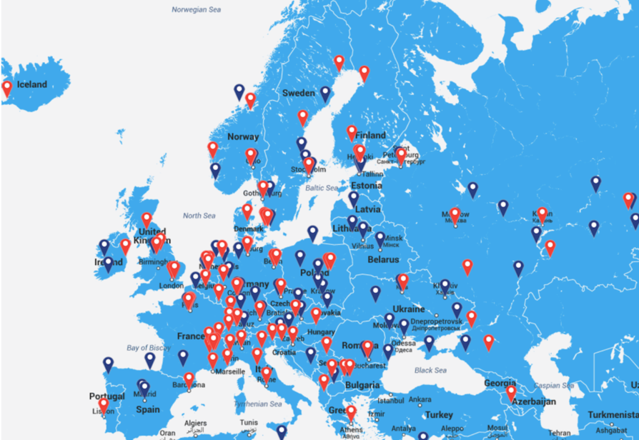
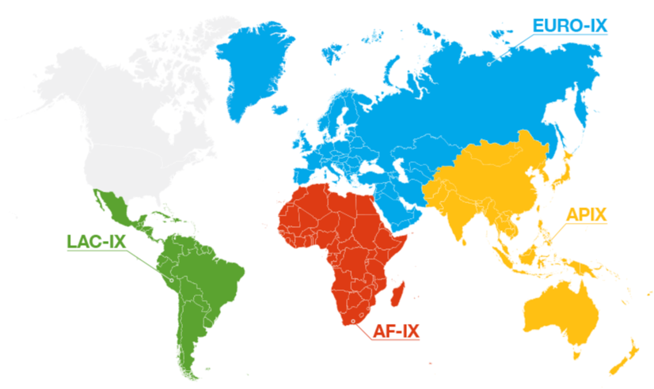
IXPs in Europe
328 known IXPs in Europe
48 Countries
326 Cities

Slide 21


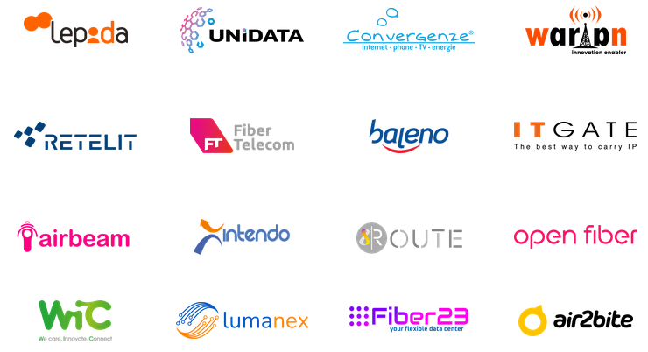
Namex
NEUTRAL COLOCATION
Space & power
Neutral, no-profit, member-based
The leading IXP in Central and Southern Italy
Website: https://www.namex.it
Meet me room
Remote hands
PEERING
Time as a service
Remote IXP
189
Rack in colocation
REMOTE PEERING
Remote Aggregation
1600
Private Network Interconnections

Slide 22
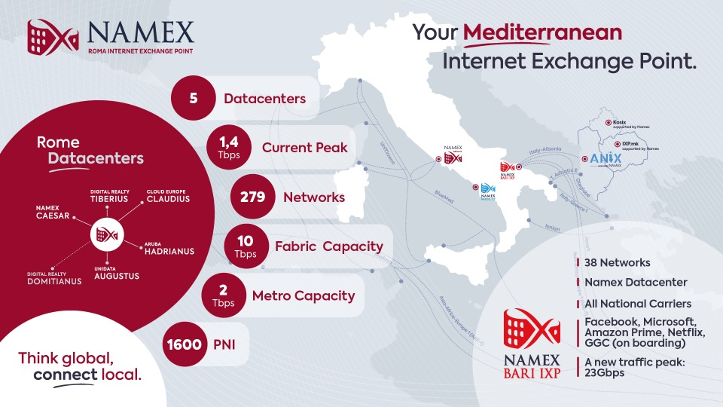

Slide 23
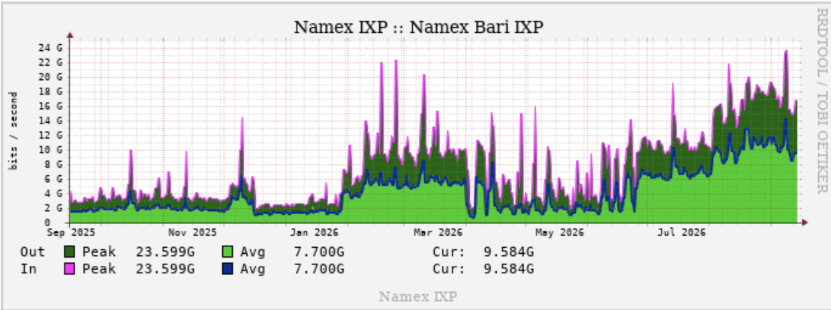
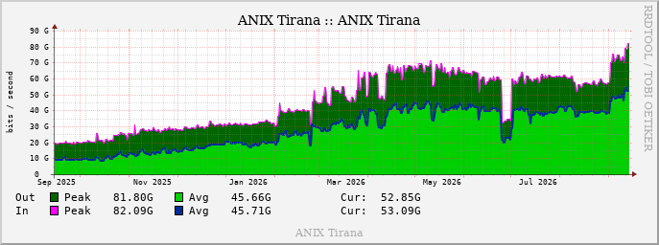
Google GGC effect
New traffic peak 82G for ANIX

Slide 24
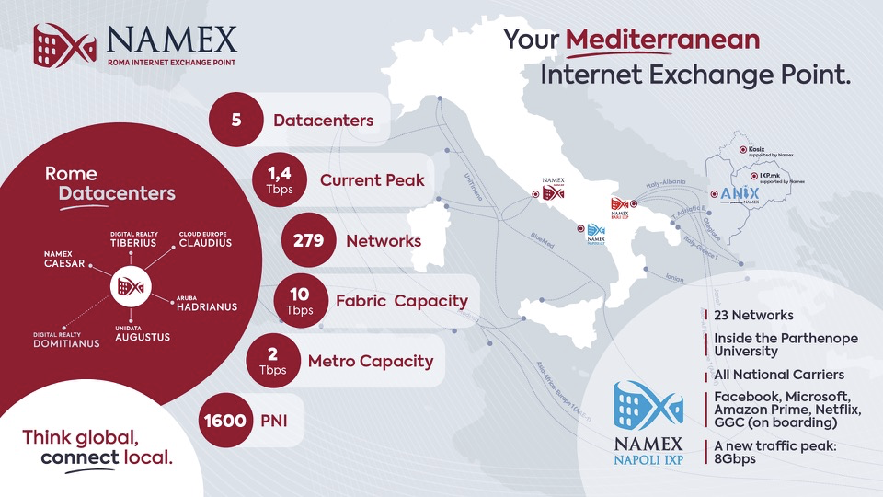

Slide 25

School of Advanced Networking
150+ Participants
Trained annually
80 Companies
Reached across the tech and telecom ecosystem
Free High-Level Training
Hosted annually, covering the most relevant technical topics in network engineering

Slide 26




NAM2027 - Namex Annual Meeting
SAVE THE DATE
24-25 Maggio
NAM2027
Namex Annual Meeting
Rome • Coming Soon

Slide 27

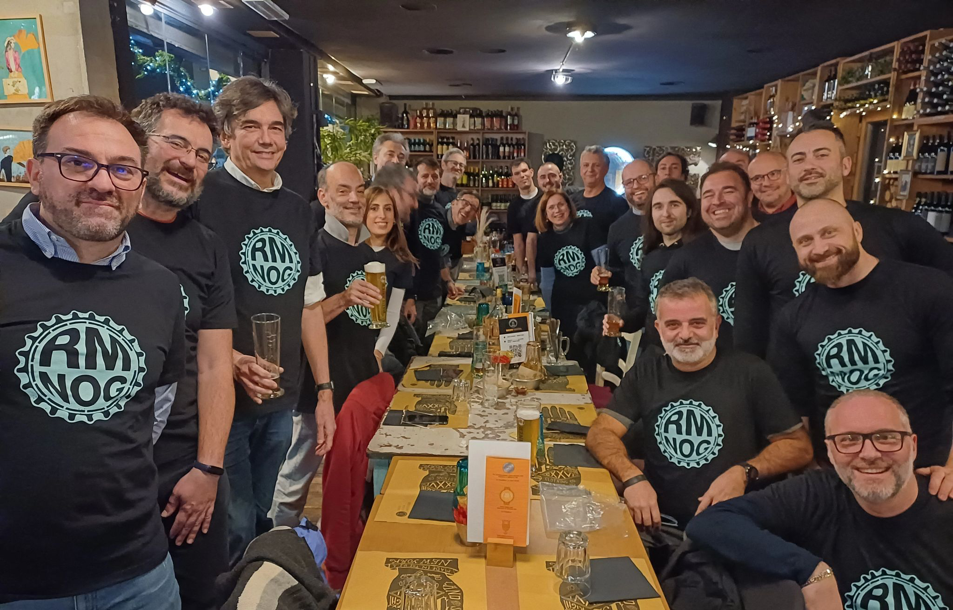
RMNOG
Monthly Community Meetups
Every 3rd Tuesday
Namex brings together Network engineers and tech executives in Rome.
Informal & Social
Designed for relaxed networking, technical idea-sharing, and a good beer.
https://www.rmnog.org/

Slide 28
Q&A
Namex.it

Slide 29
References
https://resources.telegeography.com/what-is-the-trombone-effect
https://www.csis.org/analysis/strategic-future-subsea-cables-egypt-case-study
https://www.middleeasteye.net/news/google-egypt-suez-digital-internet-flow-change-middle-east?utm_source=gemini
https://labs.ripe.net/media/documents/RIPE_NCC_Middle_East_IXP_Report_2024.pdf
https://www.internetsociety.org/resources/doc/2014/ixptoolkitguide/

